Slide 1
Overview of Supervised Learning
2021.01.04
Young-In Kwon

Slide 2
Context
1. Introduction
2. Variable Types and Terminology
3. Two Simple Approaches to Prediction
4. Statistical Decision Theory
5. Local Methods in High Dimensions
6. Statistical Models, Supervised Learning and Function Approximation
7. Structured Regression Models - (skip)
8. Classes of Restricted Estimator - (skip)
9. Model Selection and the Bias-Variance Tradeoff

Slide 3
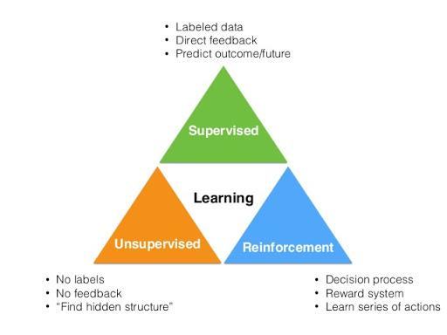
1. Introduction
Notes:
what is supervised learning?
As i hope, you guys know about it already. There are three types of learning mechanism in ML
These are Supervised Learning, Unsupervised Learning, and Reinforcement Learning.
One of them is Supervised Learning that there has actual result value for prediction to minimize error between real value and predicted value. And it’s our topic of this chapter.

Slide 4
2. Variable Types and Terminology
Type of Variables
Qualitative Variable
Quantitative Variable
Notes:
In ML process, there are datas what we handle. target value what we said before is also data.
data seems like ‘Matrix’ what has row and column. row is individual point of data and column is variable what we will talk about. data type is defined per column(variable). what types of data are they?
There are two type of variable
Qualitative variable
Qualitative variable is no sequence each other and used like ‘class’. it says ‘categorical’ or ‘discrete’. sometimes qualitative variable represent to ‘dummy variable’ shape what spreads those column-wisely using binary value. But if it has order between class it’s called Ordered Categorical variable compared with previous non-order categorical variable. I think we couldn’t use dummy method cuz It would lose information about seqeunce.
Quantitative variable
Quantitative variable has discrete and continuous value what doesn’t seem like simple class(Qualitative variable).

Slide 5
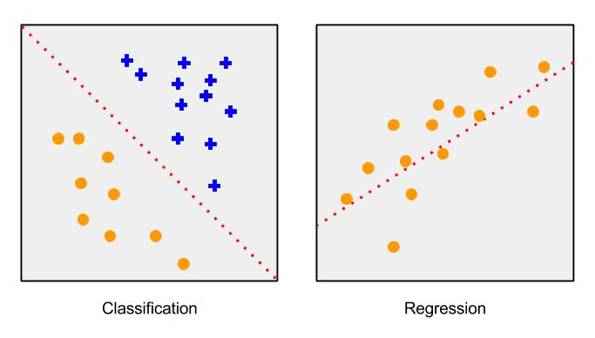
2. Variable Types and Terminology
Problem Definition by data type
Notes:
In supervised learning what I said before, there are two problem definition.
There are Classification and Regression problem by dividing output variable data type
Classification has ‘Qualitative target variable’
Regression has ‘Quantitative target variable’
But whether there is classification or regression problem, we could take similar approach via ‘function approximation’. so huge difference is not occurred by problem definition.

Slide 6
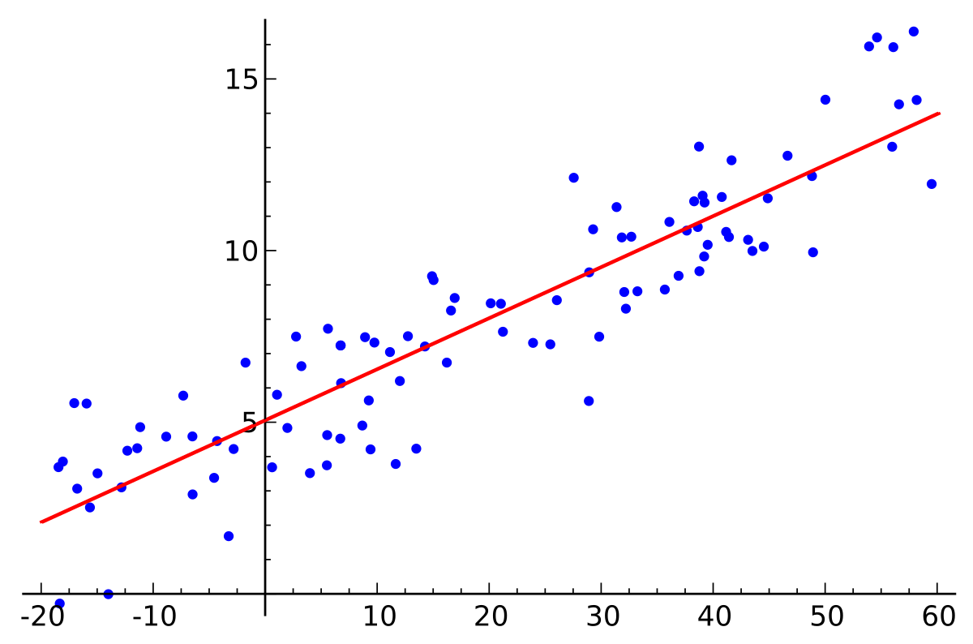

3. Two Simple Approaches to Prediction
linear model and least squares
Notes:
linear model is drawing regression line to the most representatively through data. and it seems linear equation with sum of one intercept and many feature with weight. so it could represent equation 2.1 and if we thought them as matrix, intercept could represent intercept multiply with identity matrix like equation 2.2. and we call them betas after now
what is the objective of linear regression? it is to find adequate intercept and weights(betas) for drawing optimal regression line on dataset. and how to find them?
There are many methods to find, however, We could use Residual Sum of Square(RSS) method for it

Slide 7
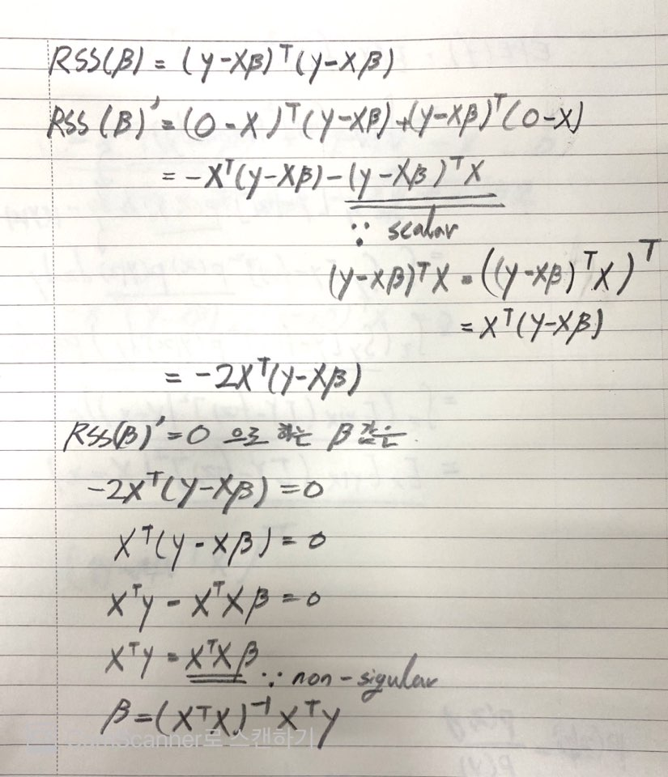

3. Two Simple Approaches to Prediction
linear model and least squares
Notes:
There are many methods to find, however, We could use Residual Sum of Square(RSS) method for it.
equation 2.3 is RSS fomula to find optimal regression line. yi is actual value of data xi transpose beta is prediction value of data.
RSS could think find beta by reducing error between them.
so, we need to find optimal beta value in RSS equation. and equation 2.3 be as positive polynomial equation of beta.
To one more step, equation 2.3. can be represented by 2.4 as matrix(like eq 2.2).
And then, for minimizing it, find the point of gradient to 0.
The derivative by beta is eq 2.5. finally we could find equation 2.6 for optimal beta value.

Slide 8
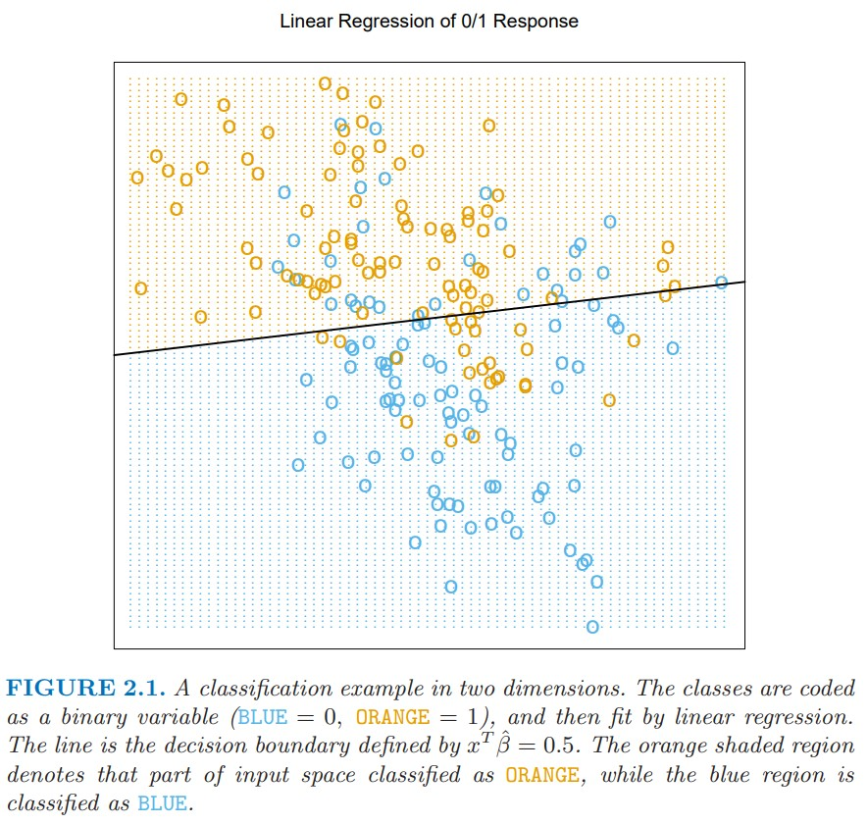
3. Two Simple Approaches to Prediction
linear model and least squares
Notes:
Here is one example of Linear Regression Classifier.
Is it looked correct to classify? there are some misclassified one unlike our intention.
how to reduce error? It will be handled later of this presentation.

Slide 9
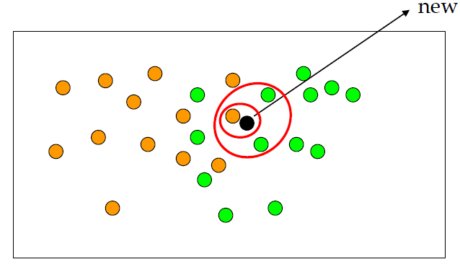

3. Two Simple Approaches to Prediction
k-nearest neighbor
Notes:
Nearest Neighbor method the way that reducing prediction value through training set’s observation.
first we could see how to classify it via left figure.
If I wanna classify one new point on the training dataset, we define number of neighbors(k) for it.
If I set k =1, the point will be orange and set k=3, will be green.
and how it works in mathematically? it’s equation is right side of this slide.
if i set orange =1 and green =0,
in k=1 the value of y hat will be 1/1 * (1) = 1
in k=3 the value of y hat will be ⅓ * (1+0+0) = ⅓
and if we set prob of classification between them fairly, 0.5 each other.
k=1, Orange; k=3, Green.

Slide 10
3. Two Simple Approaches to Prediction
k-nearest neighbor
Notes:
first we could see how to classify it via left figure.
If I wanna classify one new point on the training dataset, we define number of neighbors(k) for it.
If I set k =1, the point will be orange and set k=3, will be green.
and how it works in mathematically? it’s equation is right side of this slide.
if i set orange =1 and green =0,
in k=1 the value of y hat will be 1/1 * (1) = 1
in k=3 the value of y hat will be ⅓ * (1+0+0) = ⅓
and if we set prob of classification between them fairly, 0.5 each other.
k=1, Orange; k=3, Green.

Slide 11
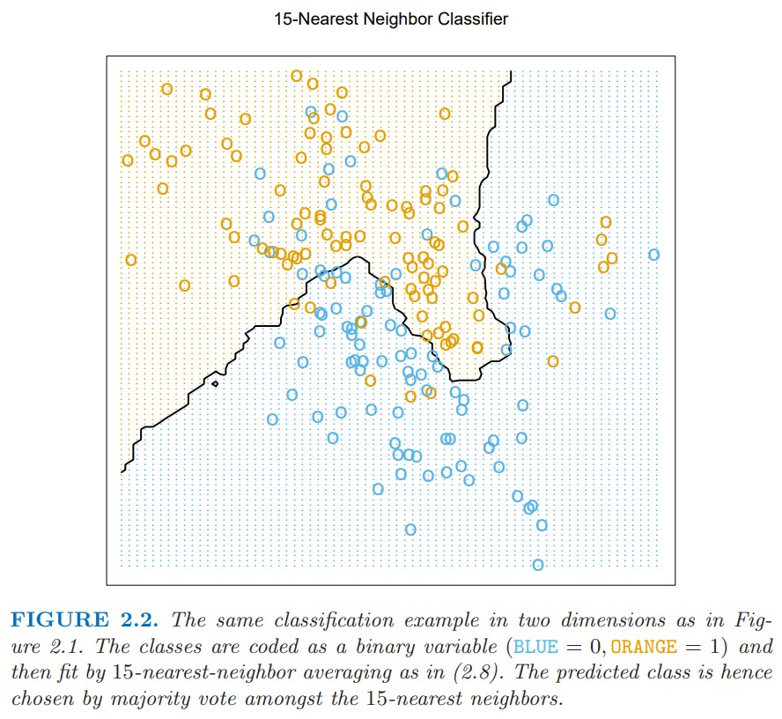
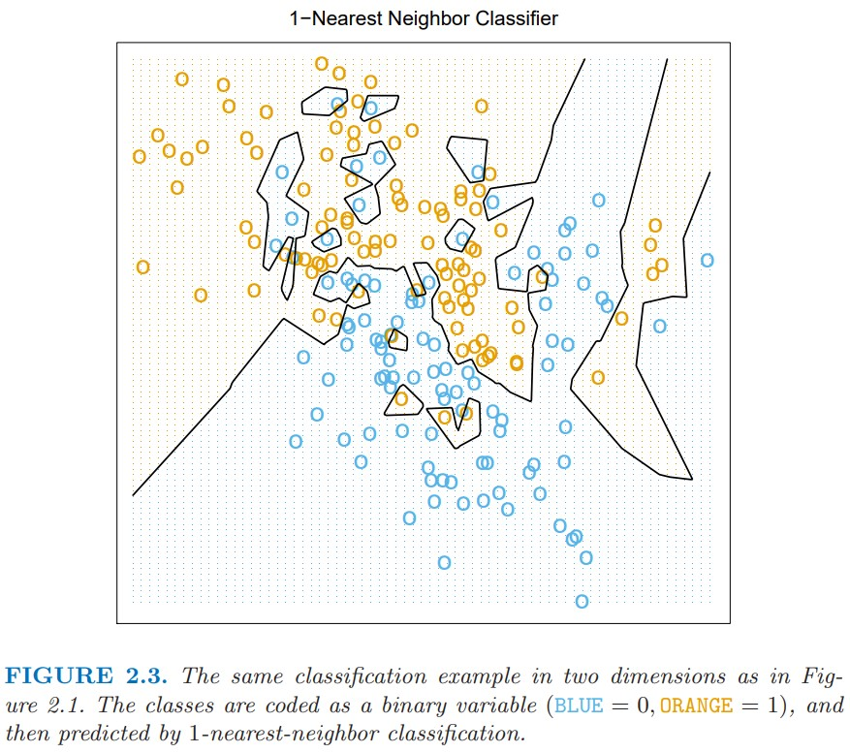
3. Two Simple Approaches to Prediction
k-nearest neighbor
Notes:
comparison between two nn model (k=15 and k=1).
decision boundary of k=15 seems better than linear model. and decision boundary of k=1 seems that there is no misclassification and detail dividing about two classes.
Then we could think, ‘choose k=1 always get correct answer without any misclassification!’. but it’s not.
There are some problems by selecting k=1, one of those is over-fitting that will be described later as well.
then what is the optimal value of k?
= makes N/k more than parameter p of linear model(the number of features).

Slide 12
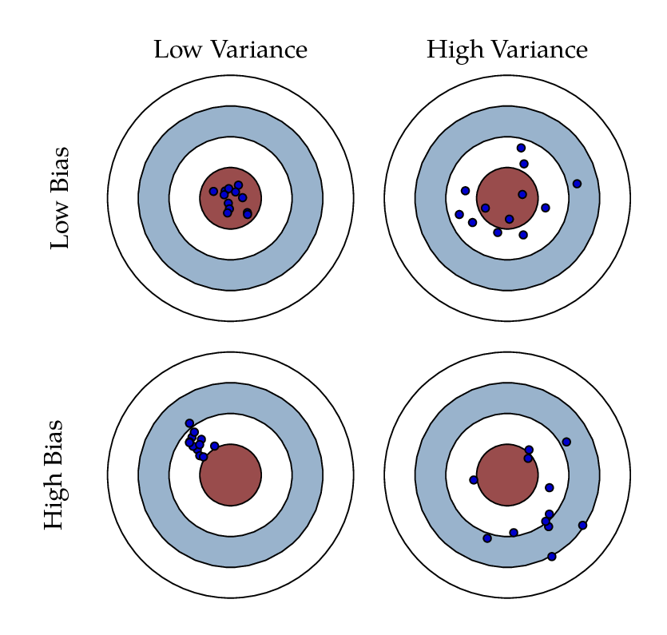
3. Two Simple Approaches to Prediction
comparison
Nearest Neighbor
Linear model
Notes:
Linear Model has strong assumption optimal decision boundary seems linear. So, model has high bias and Low variance.
Nearest Neighbor has any strong assumption unlike linear model and it can adopt any situation. but, the specific point of decision boundary is unstable
So, model has low bias and Low variance.

Slide 13
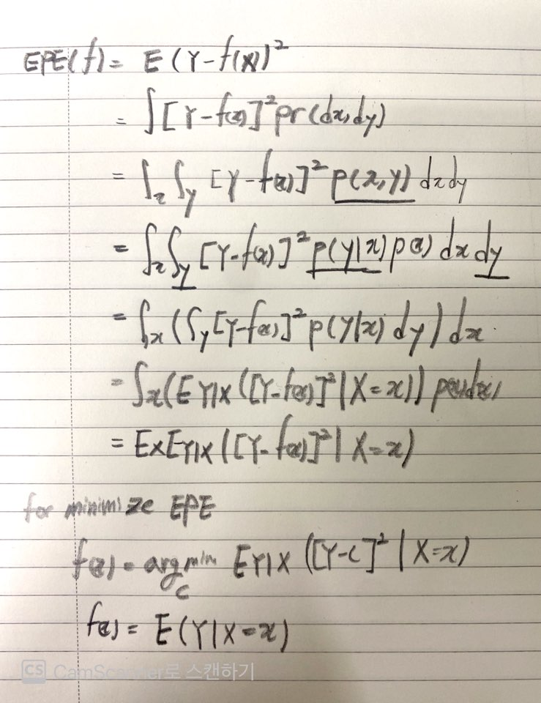

4. Statistical Decision Theory
Quantitative Variable
Notes:
make some development about our theories what we discussed.
I think, Statistical Decision Theory means that how to decide the parameter for the most optimal regression line in Statistical way.
first, it’s about quantitative output.
we define X is random input vector what has p column and Y is also random real value vector.
the objective is find function f(X) for predicting Y given X vectors.
for doing that we need some penalties at the function. among them, squared error loss is very common and simple one we talk about.
according to this, the criterion of choosing function f is Expected Prediction Error(EPE).
EPE seems like equation 2.9. and it will be derived equation 2.13 by some processes like the right side of slide.
eq 2.9 convert to probability density function form like 2.10. and use concept of conditional probability. it will be equation 2.11
furthermore, we need to minimize EPE(X) point-wise ‘c’ like equation 2.12.
and the final solution seems like eq 2.13

Slide 14

4. Statistical Decision Theory
NN and Linear Regression
Notes:
nearest neighbor 방식은 주변의 k neighbor point들에 대한 평균으로 표현 가능하기 때문에, 예측을 위한 function f hat은 equation 2.14와 같이 표현할 수 있다.
but there are two approximation for defining like eq 2.14
expectation is approximated by averaging over sample data;
conditioning at a point is relaxed to conditioning on some region “close” to target point.
In nearest neighbor, the bigger N value makes there are many neighbors specific x point and the bigger k value and average value will be stabilized.
So, eq 2.14 can be seem like 2.13
In Linear model, if we assume f(x) like eq. 2.15, we could find optimal beta value such as eq 2.6 replacing the expectation by average over training data.
(why???)
both NN and Linear Regression replace Expectation to Average by approximation. but they have different model assumptions.
Least Square: function will be globally linear function
Nearest Neighbor: locally constant function

Slide 15

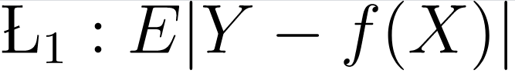

4. Statistical Decision Theory
Further thinkings
Notes:
see the eq 2.17, it describes additive model among rigid linear models.
optimal estimate of additive model will be derived by approximation per Xj columns vector.
So, it could sweep away high dimensionality problem.
and, do you remember Squared Error Loss function before? or how about using absolute value for Loss function.
if we use absolute value as L1 loss, the result of prediction function will be median value around all x values.
But, author said L2 would be prefer than L1.
There are some reasons why.
L2 loss is more robust than L1 when it encounter with outlier value.
L1 has discontinue property when L1 value being 0 due to derivative.

Slide 16
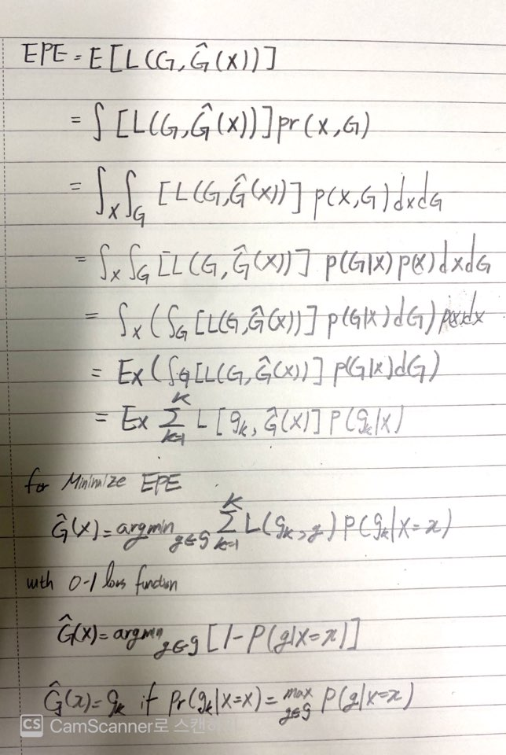


4. Statistical Decision Theory
Categorical Variable
Notes:
Now we could expand loss function for multi-classification loss.
Loss function L has K rows and columns what has 0 values for diagonal and nonnegative value elsewhere.
and L(k,l) means the cost spends when class k specify I instead of actual value.

Slide 17
5. Local Methods in High Dimensions
Curse of Dimensionality
The curse of dimensionality refers to various phenomena that arise when analyzing and organizing data in high-dimensional spaces that do not occur in low-dimensional settings such as the three-dimensional physical space of everyday experience.
Notes:
we have discussed two major prediction models that one is linear model and nearest neighbor.
In nearest neighbor, for getting good prediction result, Large data samples and high number of neighbors is needed during prediction.
But it’s not when high dimensional space (parameter p value increased in linear model). It’s one of the curse of dimensionality symptoms.
Now, we will talk about the symptoms in High Dimension dataset.

Slide 18
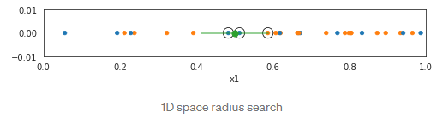
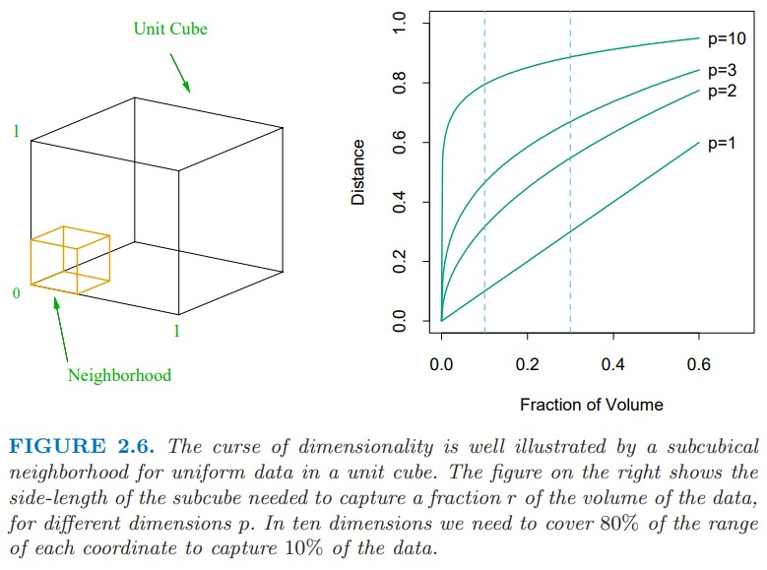
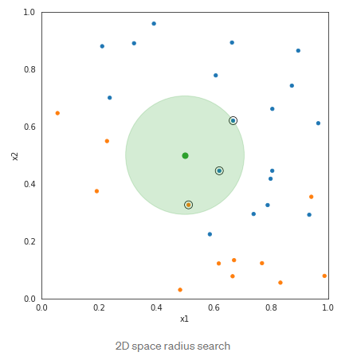
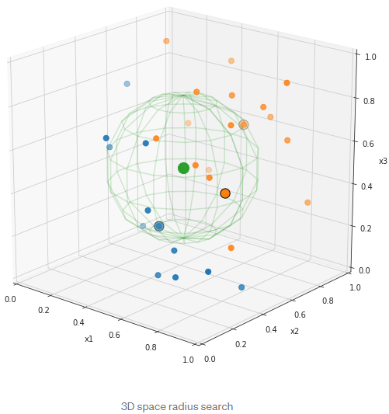
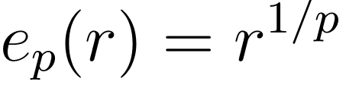
5. Local Methods in High Dimensions
1. Distance among neighbors
r=0.01 => 63%
r=0.1 => 80%
Notes:
inputs of nearest neighbor are uniformly distributed like left image as p-dimensional cube.
and action to capture fraction r of observation also would be hypercubical neighborhood.
and expected distance length between neighbor is ep(r) = r 1/p.
if we want to get 1% of data to local average must cover 63% and 10% need to cover 80% of input.
So neighbor could not say ‘local’.
https://towardsdatascience.com/k-nearest-neighbors-and-the-curse-of-dimensionality-7d64634015d9

Slide 19


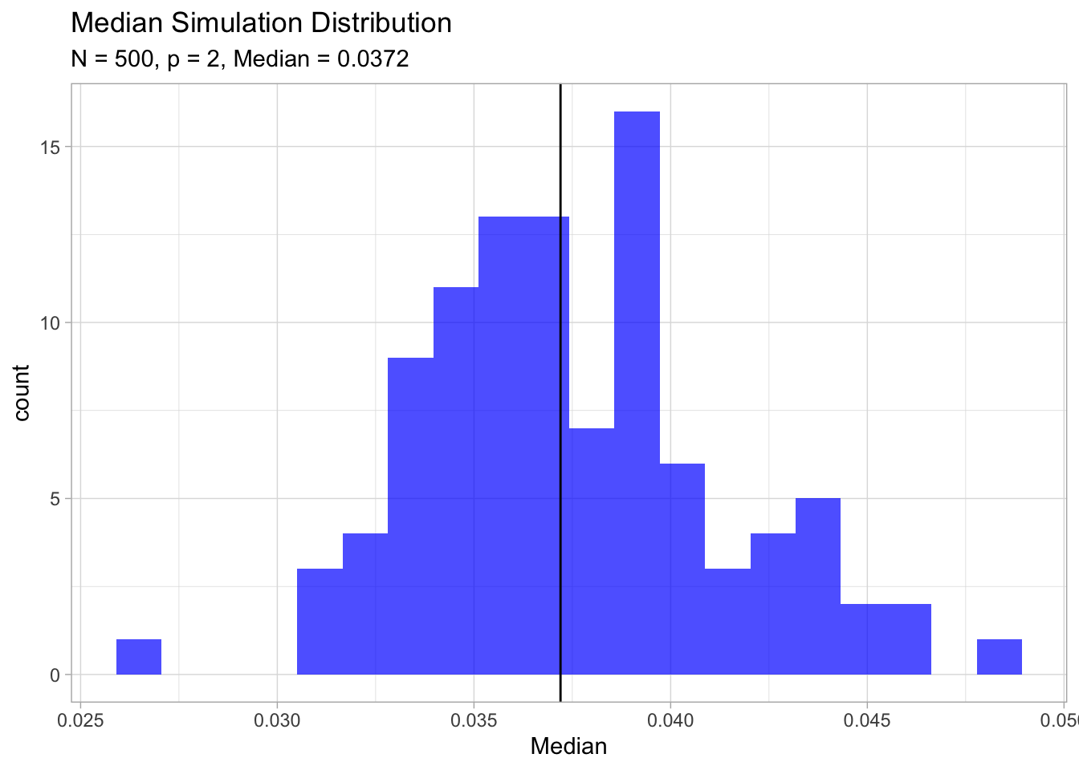
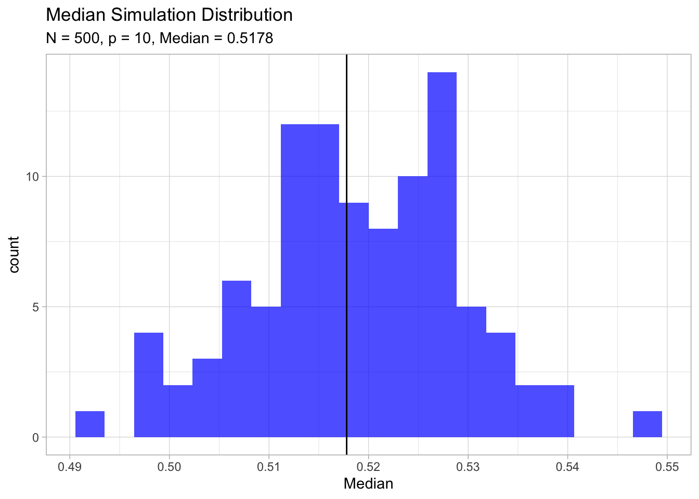

5. Local Methods in High Dimensions
2. Be close to an edge of sample
3. Diminishing sampling density
N1=100, dimension=1; sample size=100;
for same proportion in 10 dimension,
amount of samples above is needed
Notes:
we keep thinking about p-dimensional unit ball centered at the origin.
The equation 2.24 means the median distance from origin data point to neighbor.
if N=500, p=10 then d(p,N) = 0.52, it says more than half of data near to boundary from origin data point.
The reason why it is problem is prediction is much more difficult near the edge of training sample(estimating point extrapolate vs interpolate).
https://stats.stackexchange.com/questions/206295/curse-of-dimensionality-why-is-it-a-problem-that-most-points-are-near-the-edge
https://juanitorduz.github.io/exploring-the-curse-of-dimensionality-part-ii./
Sampling Density will be changed by size of dimension p and It’s equation N^{1/p}
if p=1, and its number of sample 100.
and compare it with high dimensional space p=10.
for same density, N_10 = 100^10 data is needed!.
and In high dimensional space we need much more data be trained.

Slide 20
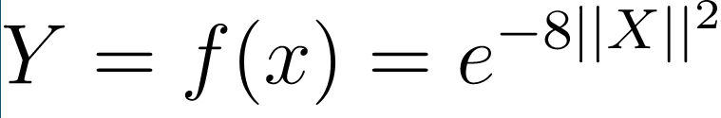
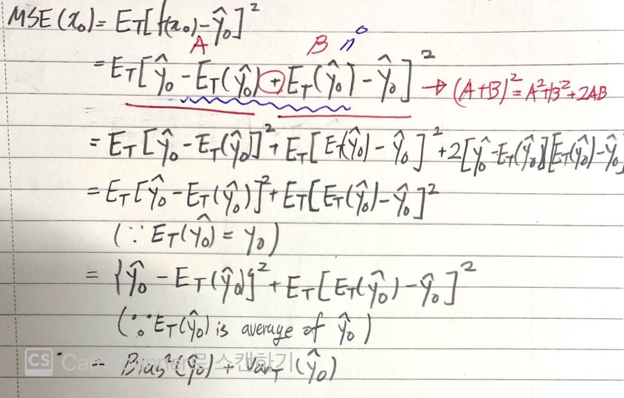
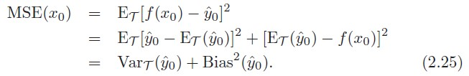
5. Local Methods in High Dimensions
About Bias and Variance
Bias: how much close samples average result with answer
low - good prediction via repeats
high - not good prediction despite to do many repeats
Variance: difference between samples average and one sample
low - constant approximation value by changes of sample
high - volatile approximation value by changes of sample
Notes:
Now, we gonna talk about Bias and Variance in MSE of example for understanding eq 2.25 and Figure 2.7.
for checking MSE, define one example there are 1000 data points xi uniformly on [-1,1]^p and Y = f(X) = e −8||X||.
and to get MSE value in simple way, it uses 1-nearest-neighbor. and think about x0 point only.
how to get MSE value at x0 point via Expectation of Square Error btw optimal function f(x0) and prediction value y hat 0 like top of eq 2.25.
for doing that, we need to do some excecutions of y0 hats like getting sample using another data samples and average them for estimating MSE.
the simbol what I’m saying now is Et(y hat 0) means Expectation of y hat 0 via some datasets.
adding addition and substraction of Et(y hat 0) itself on top of eq 2.25.
it seems like second line of picture on the right side of slide.
And then substitution left red line as A and right red line as B.
It will be sqaure on sum of two variables, A and B.
according to another equations below, finally we could get \{\hat{y_0}-E_t(\hat{y_0})\}^2+E_t[E_t(\hat{y_0})-\hat{y_0}]^2, the second line from the bottom.
the left side of it be as Bias and the right side of if be as Variance using words what I commented in previous slide.
then, what is bias and variance?
Bias: how much close samples average result with answer
low - good prediction via repeats
high - not good prediction despite to do many repeats
Variance: difference between samples average and one sample
low - constant approximation value by changes of sample
high- volatile approximation value by changes of sample
So, we decompose bias and variance using Expectation of Loss function using example.
It’s called Bias-Variance Decomposition and two concepts have adopts to check the degree of ML model training.
https://ratsgo.github.io/machine%20learning/2017/05/19/biasvar/
https://www.youtube.com/watch?v=mZwszY3kQBg

Slide 21
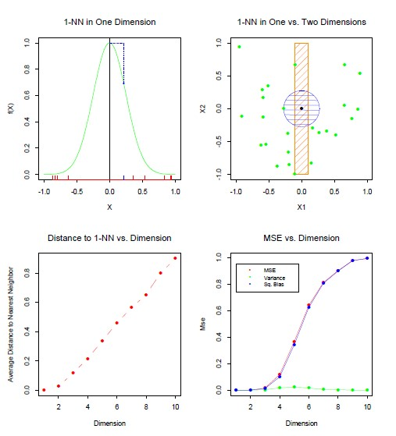
5. Local Methods in High Dimensions
About Bias and Variance
Notes:
Then let us turn back the result of example.
like some symptoms of the curse, the distance is getting far away with neighbor by increasing number of dimensions.
due to that, a data point needs to predict will be far away from target point, So, square of bias will be increased enormousely of MSE.

Slide 22
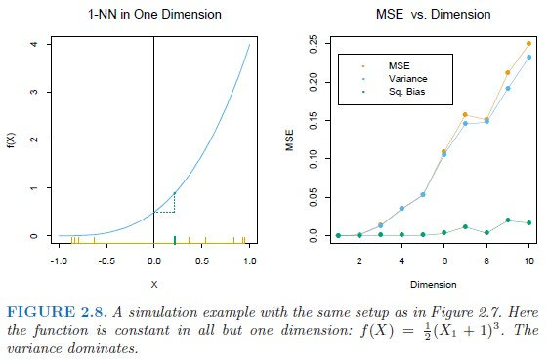
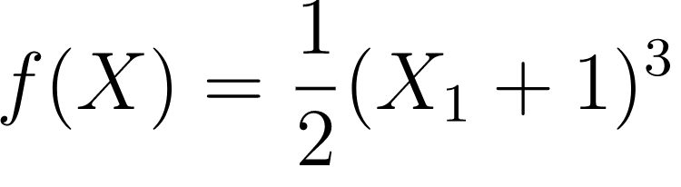
5. Local Methods in High Dimensions
About Bias and Variance
Notes:
if function f(x) become more complex than first example, f(x) be cubic equation than previous linear one.
the function what it’s more complex variance dominates in MSE unlike previous function.
I think the reason why it says about Bias and Variance by function(Model) Complexity is for showing the changes of those by complexity like Bias-Variance Trade-off problem. by handling simple example of 1-nn example.
https://stats.stackexchange.com/questions/144245/how-can-increasing-the-dimension-increase-the-variance-without-increasing-the-bi

Slide 23
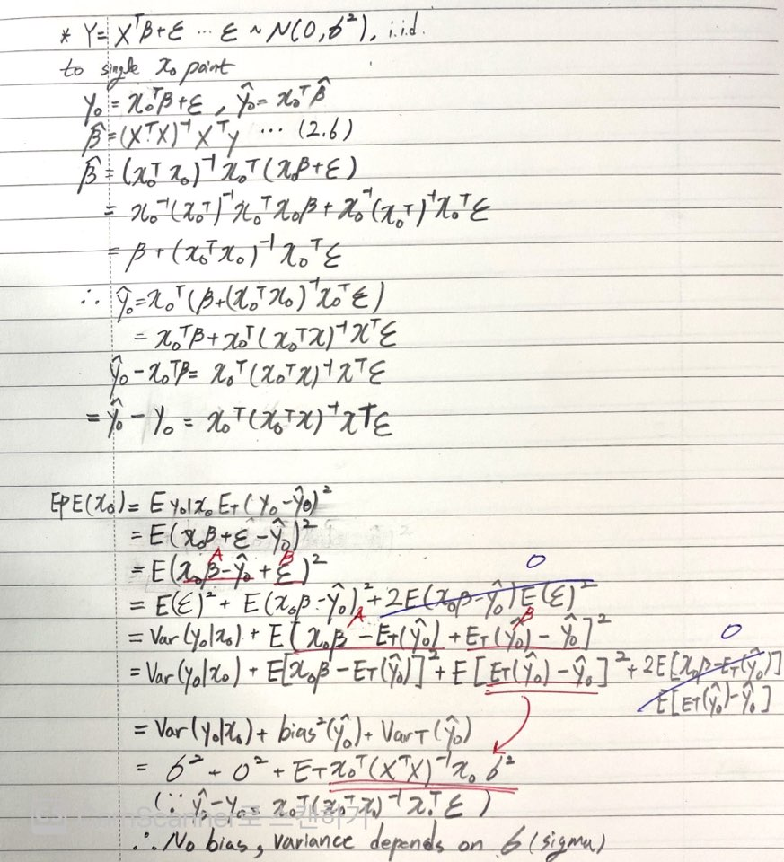

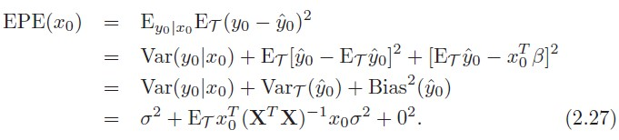
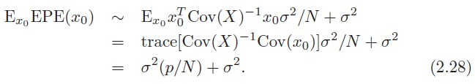
5. Local Methods in High Dimensions
Overcome the Curse in Linear model
Notes:
as next to nn model, take a look at the linear model like eq.2.26
There is epsilon variable for taking prediction error between actual and prediction value.
Through similar development process like nn-model, we could derive last equation that consist of prediction error sigma square, variance, and bias square. and the variance depends on x0.
and if we take more assumption on the equation 2.27.
These are N is large and T were selected at random, and Expectation of X is 0.
Then XT X → NCov(X). It will be derived like equation 2.28.
according to eq 2.28, EPE increased linearly as function of p, with slope sigma square divide N.
if N is large sigma square is small, effectness of p value is negligible.
Thus, linear model could handle to effect of increasing dimensionality via some restrictions like above.

Slide 24
6. Statistical Models, Supervised Learning and Function Approximation
Supervised Learning (ML)
Function Approximation (Statistics)
Notes:
There is a statistical model equation 2.29.
there is epsilon with target function f. what is epsilon here?
epsilon is measurement error as parameter for useful approximation to the truth.
so, we need something to be close the truth that’s error epsilon.
To statistical model, There are two similar words by education perspective.
First, it’s called Supervised Learning by ML perspective.
In supervised learning, we would feed training data passed by predicting function f via learning algorithm.
during the training, output will be generated f hat x per training data point.
And prediction value and actual value utilize to approximate optimal f function via differences between them.

Slide 25
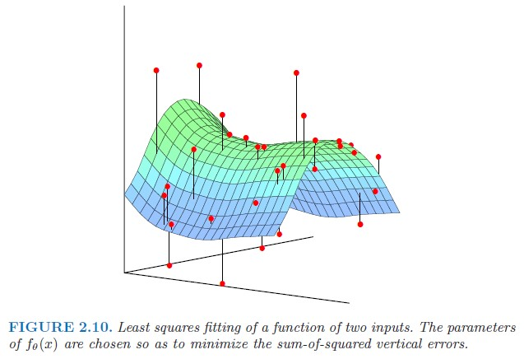



6. Statistical Models, Supervised Learning and Function Approximation
Notes:
The goal of Function Approximation is obtain a useful approximation to target function f(x) for all x, given the representations in T(Training dataset p-dimensional Real Value Matrix R^p). the book’s main approach is looking at Supervised Learning as Function Approximation.
we could represent linear model what have seen above like equation 2.30 as theta is beta and hk is transformation function of input vector x. if we without hk it seems same with eq 2.2.
if dimension value p is 2, the graph of f theta looks like figure 2.10. and residual btw actual and prediction is black bar from red point to optimal graph. optimal function f theta also could be derived RSS like eq.2.32.

Slide 26

6. Statistical Models, Supervised Learning and Function Approximation
Maximum Likelihood Estimation
Notes:
However, RSS is not the only criterion to approximate function.
Another general principle is maximum likelihood estimation.
It’s equation is 2.33. summation of density via observed sample’s value yi with log.
The principle of maximum likelihood assume that the most reasonable values for theta are the those for which the probability of the observed sample is largest. and MLE problem is defined like 2.34 has same objective RSS method.
Then, how MLE works?? let’s talk about next slide

Slide 27
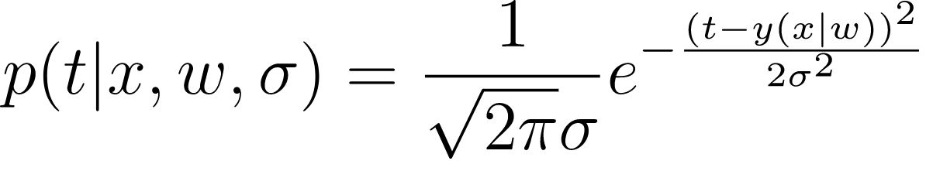
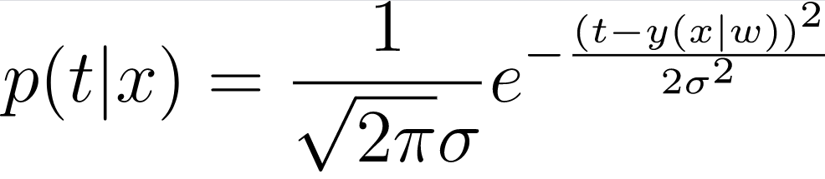
6. Statistical Models, Supervised Learning and Function Approximation
Maximum Likelihood Estimation
There is a problem to predict weight using height.
=> X: height, Y: weight, w: parameters to describe relationship between them.
To functional representation,
t[weight] = y(x|w) … conditional probability x on parameter w.
but, it needs error variable(epsilon) like linear model to approximate target and prediction value.
and w contains bias and coefficient of linear model.
according to above, weight t can be represented gaussian distribution.
t ~ N(y(x|w), σ2),
due to that w and sigma are the parameter what needs to be approximate,
Notes:
Let me talk about simple question how MLE works.
let’s see this problem as probability distribution problem.

Slide 28
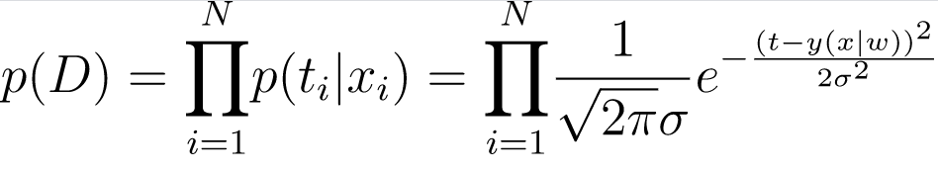
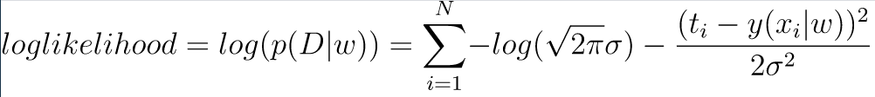
6. Statistical Models, Supervised Learning and Function Approximation
Maximum Likelihood Estimation
And represent the probability of all data points D(all datapoint xi),
By above equation, p(D) will be changed by w. So, p(D) could be replaced with p(D|w).
Finally, the model that needs to be predicted is maximizing p(D|w) at all of the data points.
It’s called as ‘Maximum Likelihood Estimation’.
The reason why take log at ‘Maximum Likelihood Estimation’ is for convenience at calculation
(for converting multiplication to summation using log’s property)
Notes:
I think this is the why it said statistical model as joint distribution probability in chapter 2.6.1.

Slide 29
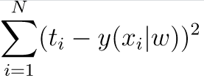
6. Statistical Models, Supervised Learning and Function Approximation
RSS and MLE
People have said like “Maximizing MLE is equal action with Minimizing Squared Loss”.
Look at the last equation we said.
Remove constants(pi, sigma) what doesn’t contribute to maximize likelihood.
Then, we could get squared loss between target value[ti] and prediction value[y(xi|w)]
So, We could say Maximizing MLE is same way to Minimizing squared loss.

Slide 30
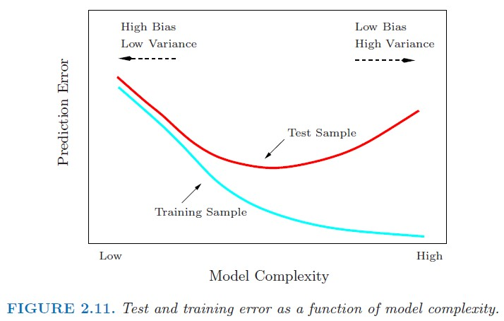
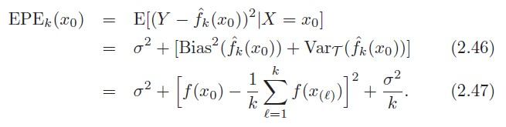
9. Model Selection and Bias-Variance Trade off
Look at the EPE(x0) equation of k-NN model below,
It also could be decompose Bias and Variance above.
If k value increased,
Bias will be increased
Variance will be decreased.

